Slide 1
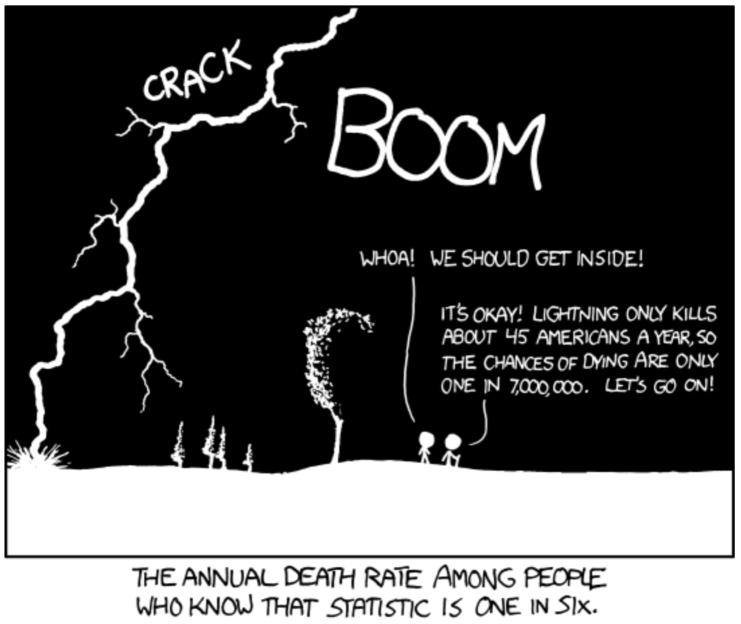
Probability and Bayes Theorem Biology 683 Lecture 3 Heath Blackmon

Slide 2
Last week
What is the difference in a population and a sample?
What is the difference in a parameter and a statistic?

Slide 3
Today
Covariance and Correlation
Probability
Frequentist vs Bayesian

Slide 4
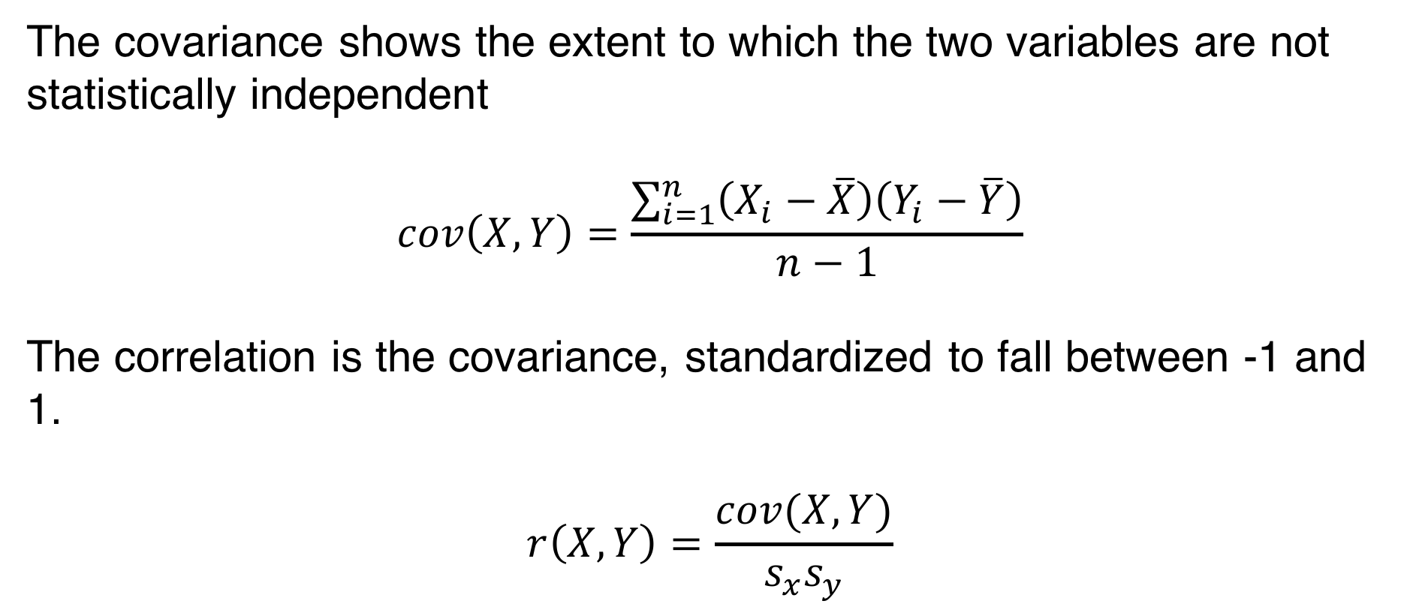
Covariance and Correlation
The covariance shows the extent to which the two variables are not statistically independent
$$cov\left(X,Y\right)=\frac{\sum_{i=1}^{n}{\left(X_{i}−\overline{X}\right)\left(Y_{i}−\overline{Y}\right)}}{n−1}$$
The correlation is the covariance, standardized to fall between -1 and 1.
$$r\left(X,Y\right)=\frac{cov(X,Y)}{s_{x}s_{y}}$$

Slide 5
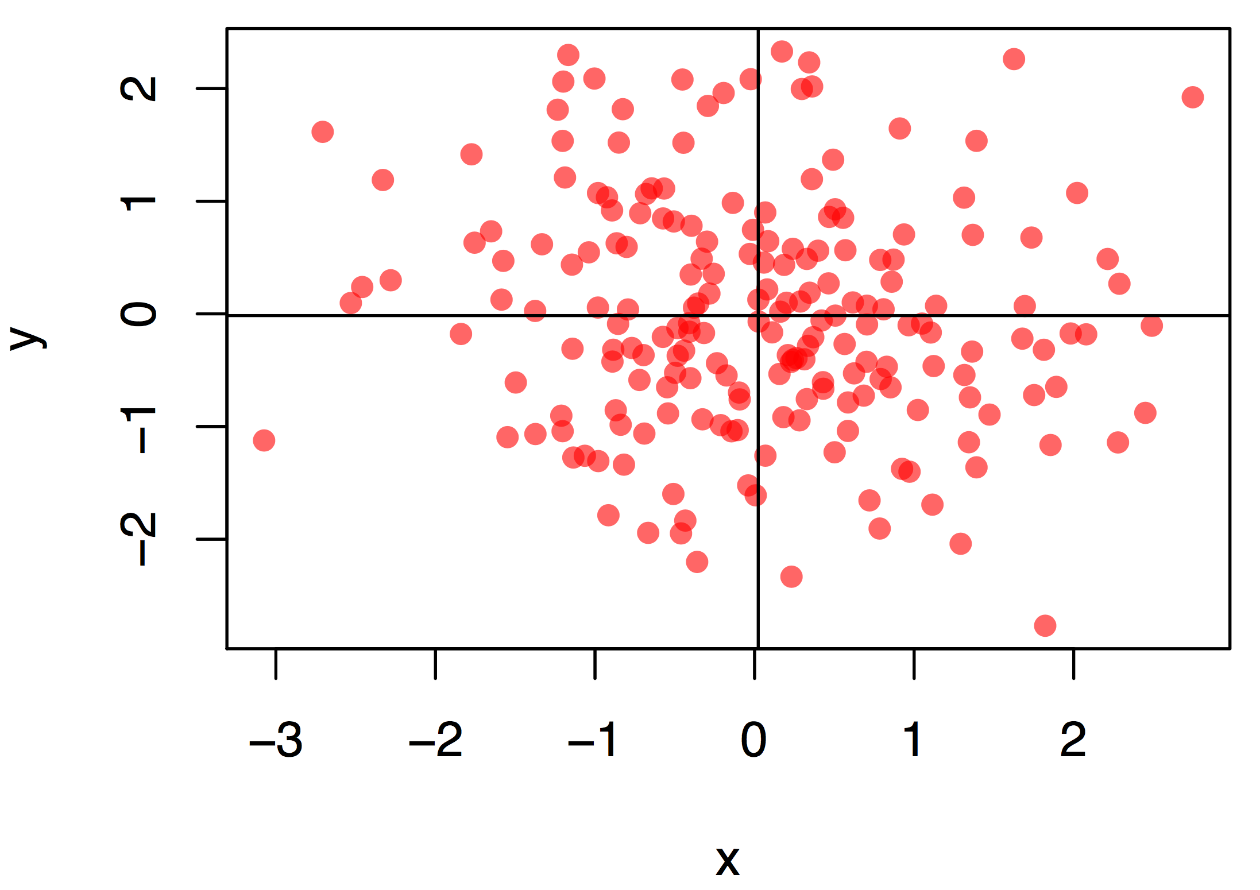
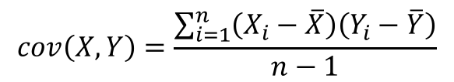
Covariance and Correlation
$$cov\left(X,Y\right)=\frac{\sum_{i=1}^{n}{\left(X_{i}−\overline{X}\right)\left(Y_{i}−\overline{Y}\right)}}{n−1}$$

Slide 6
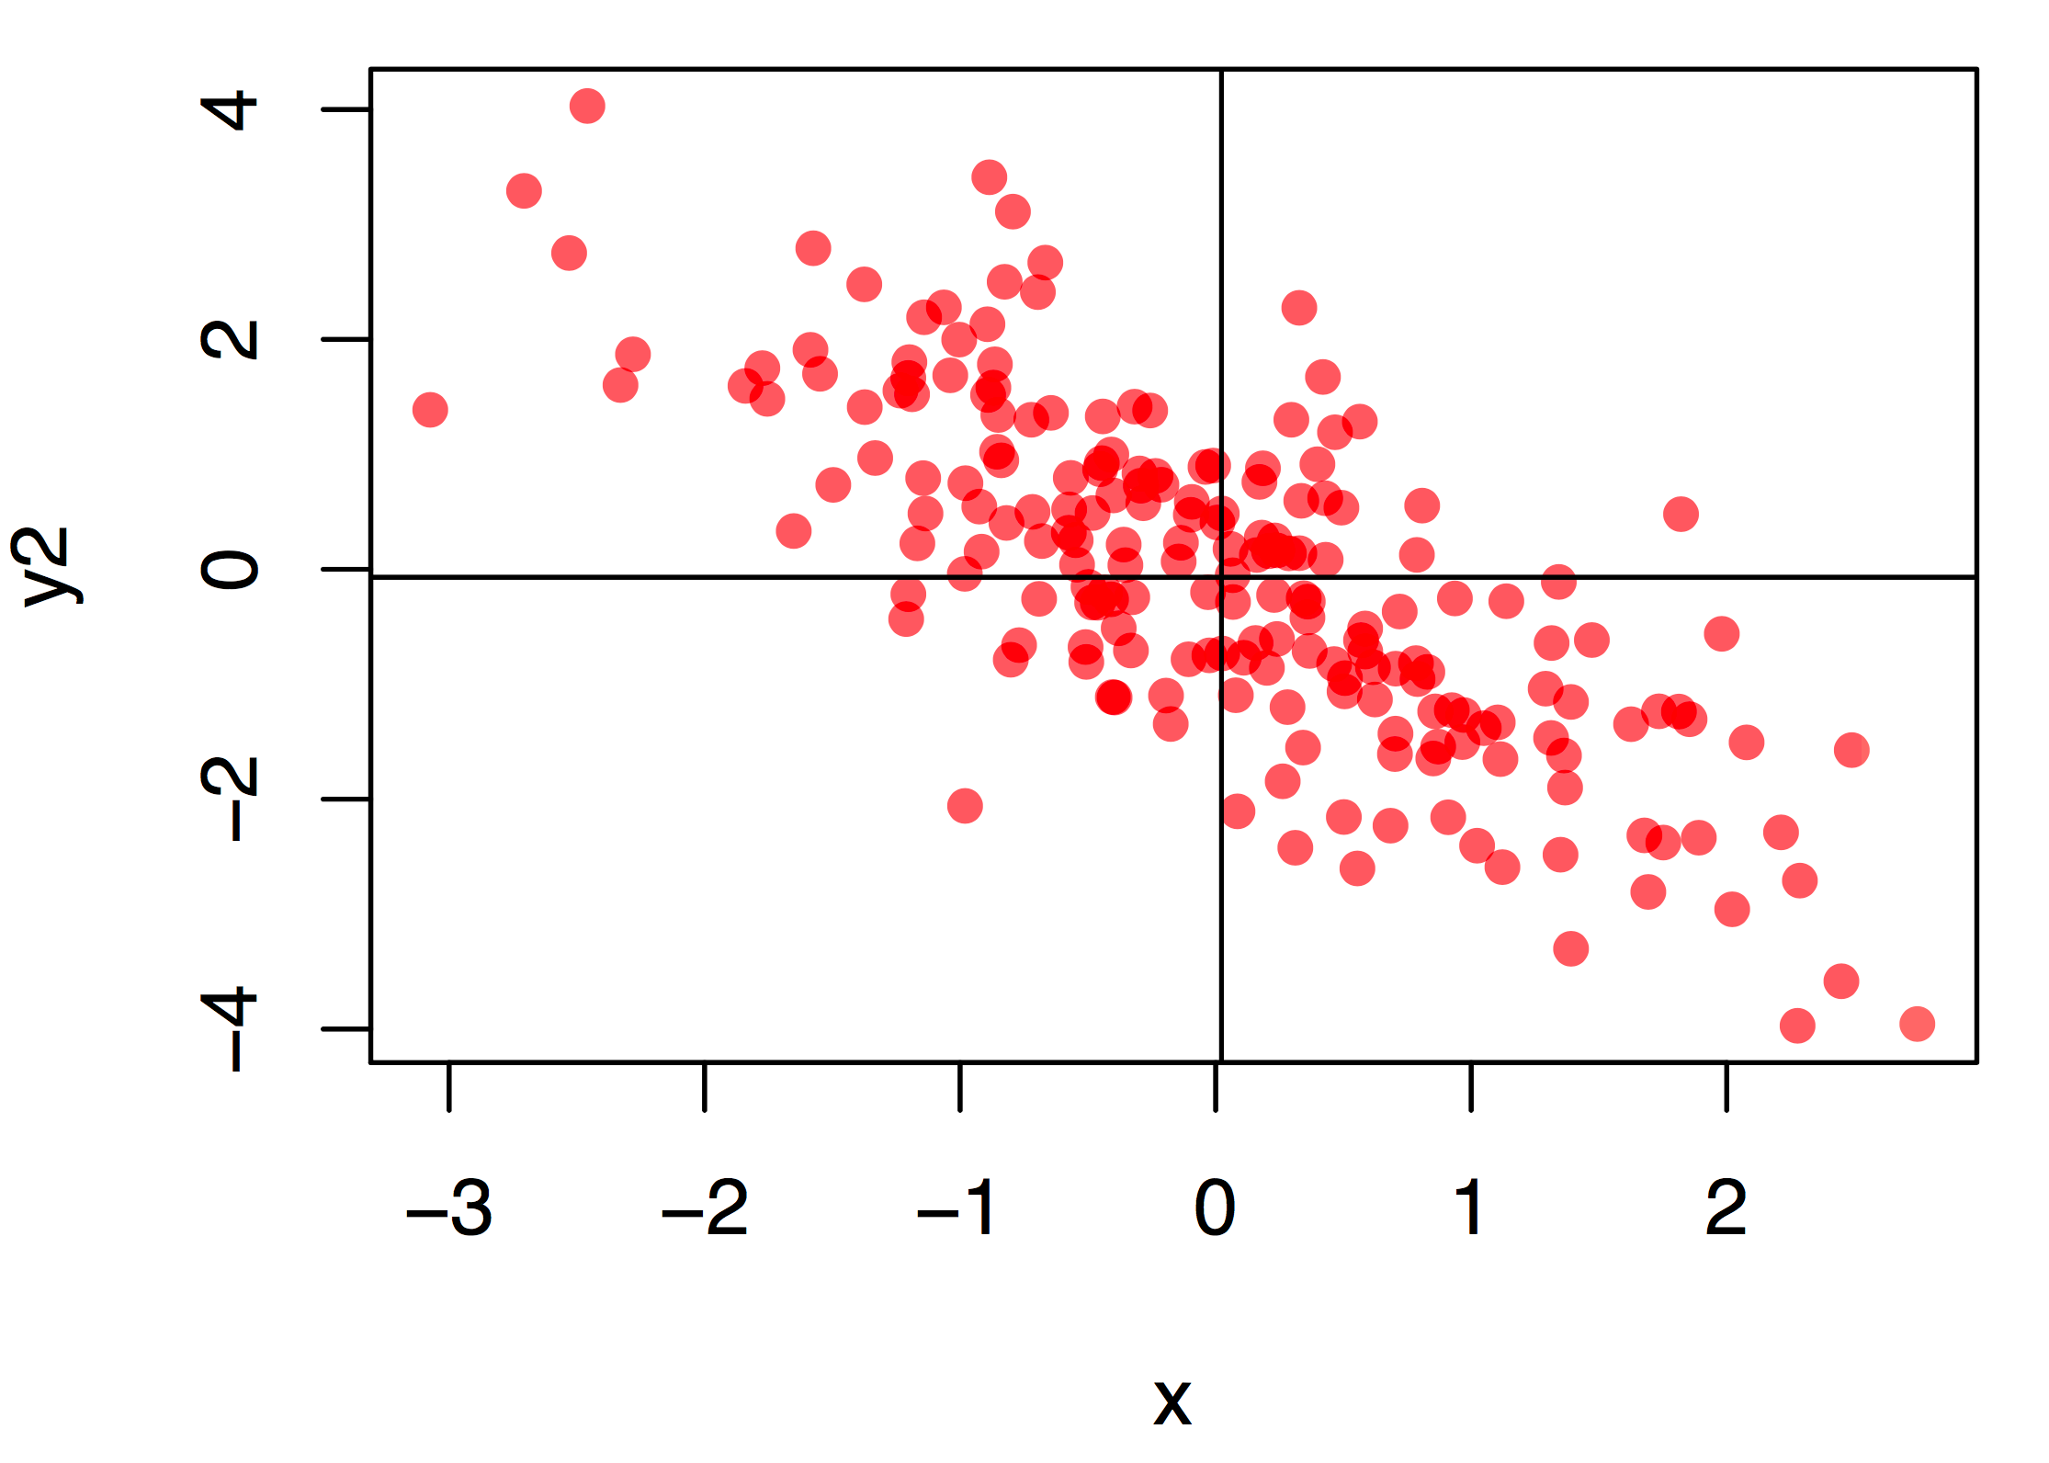
Covariance and Correlation
$$cov\left(X,Y\right)=\frac{\sum_{i=1}^{n}{\left(X_{i}−\overline{X}\right)\left(Y_{i}−\overline{Y}\right)}}{n−1}$$

Slide 7
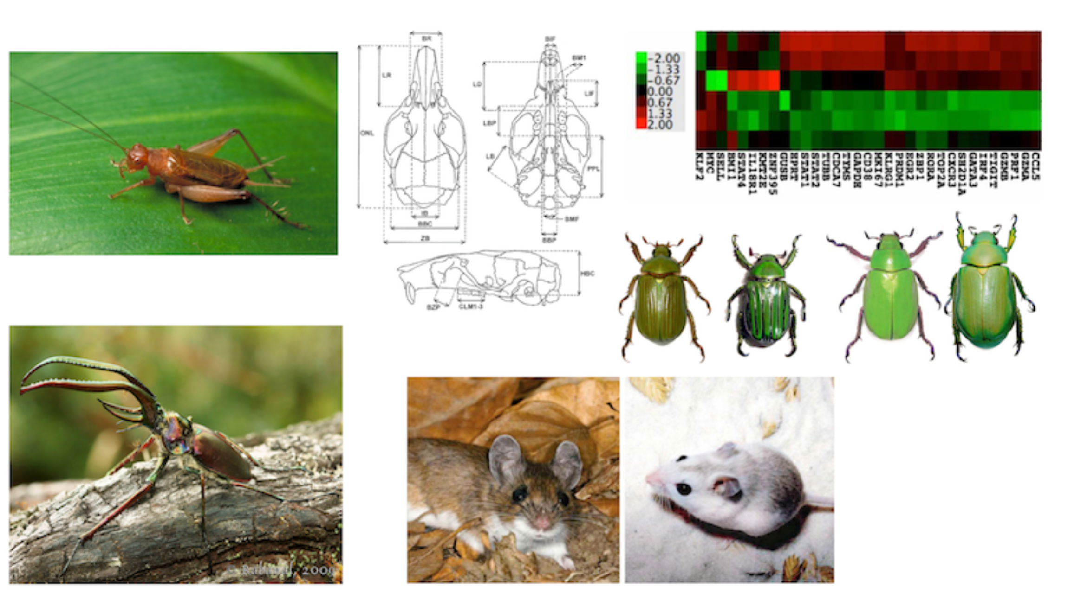
Biological examples of correlations

Slide 8
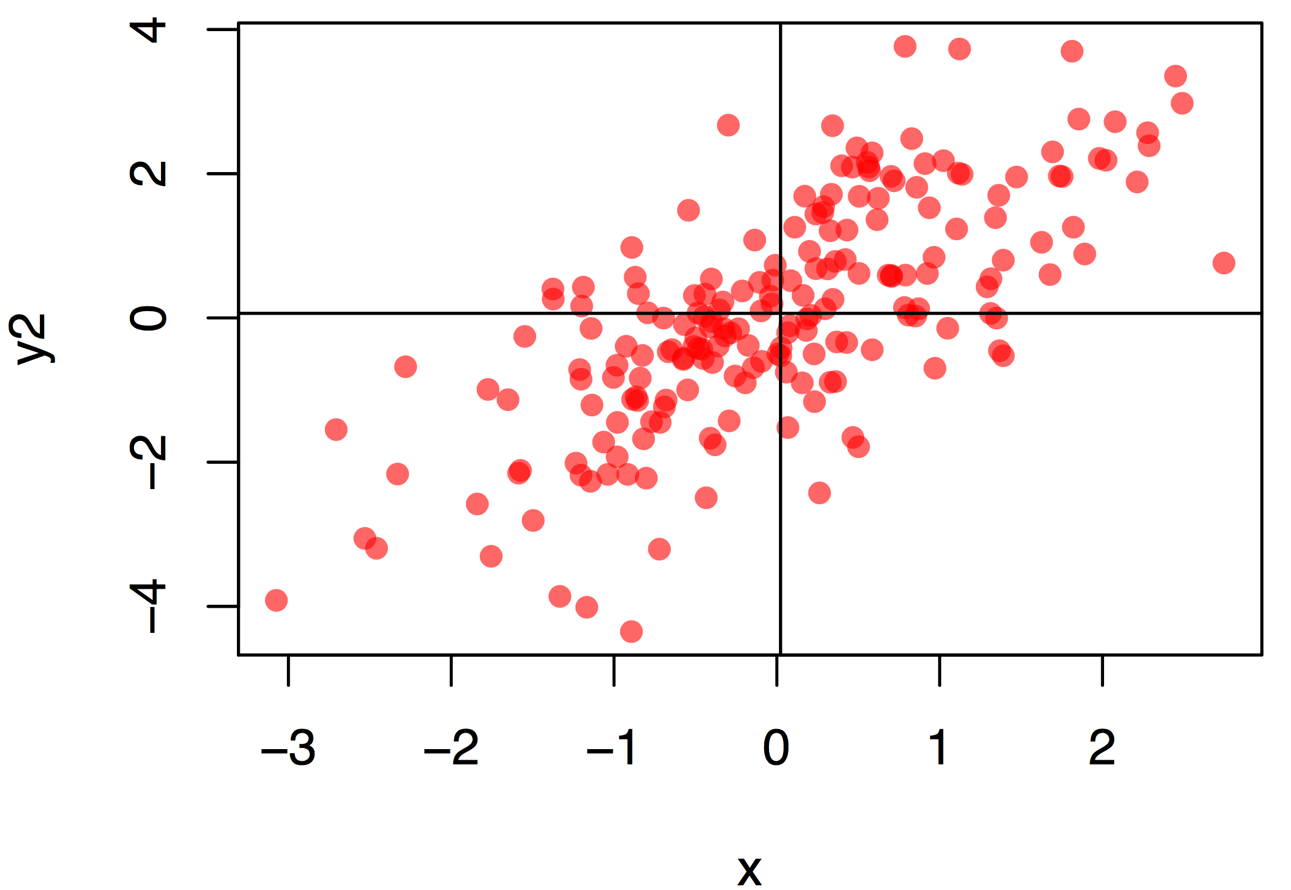
Covariance and Correlation
$$cov\left(X,Y\right)=\frac{\sum_{i=1}^{n}{\left(X_{i}−\overline{X}\right)\left(Y_{i}−\overline{Y}\right)}}{n−1}$$

Slide 9
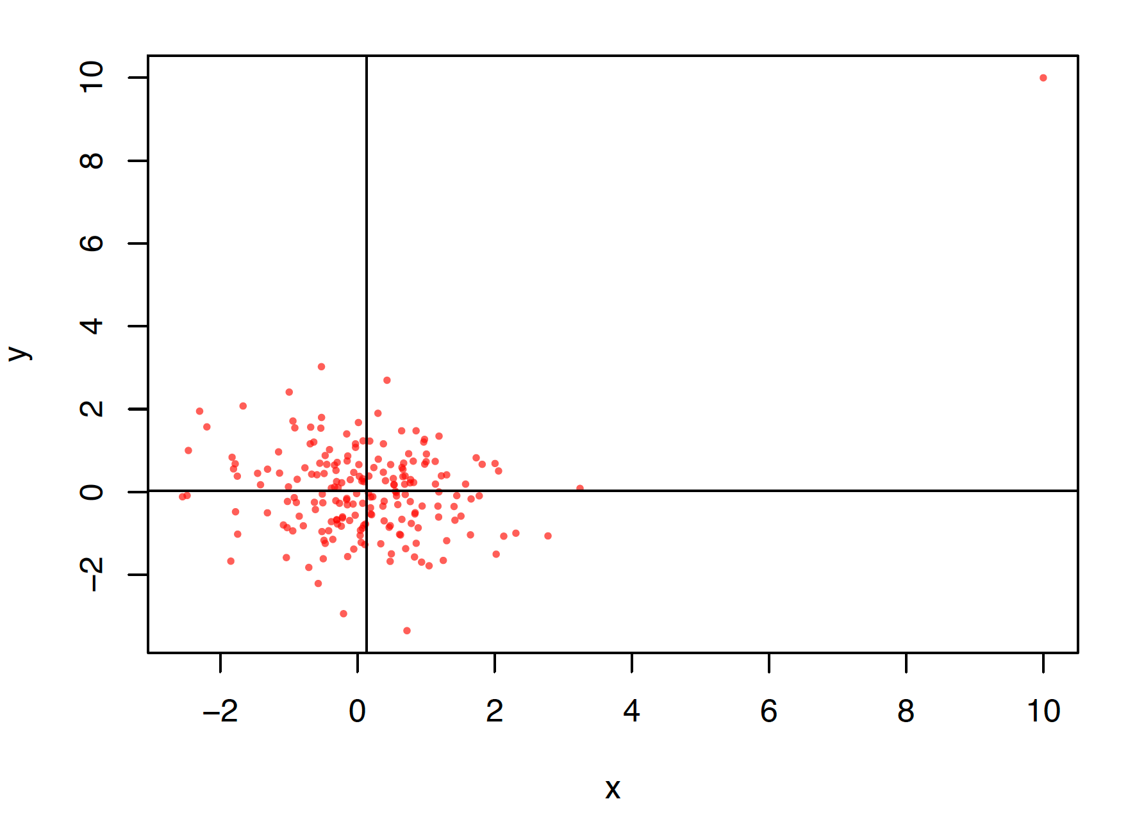
Covariance and Correlation
$$cov\left(X,Y\right)=\frac{\sum_{i=1}^{n}{\left(X_{i}−\overline{X}\right)\left(Y_{i}−\overline{Y}\right)}}{n−1}$$

Slide 10
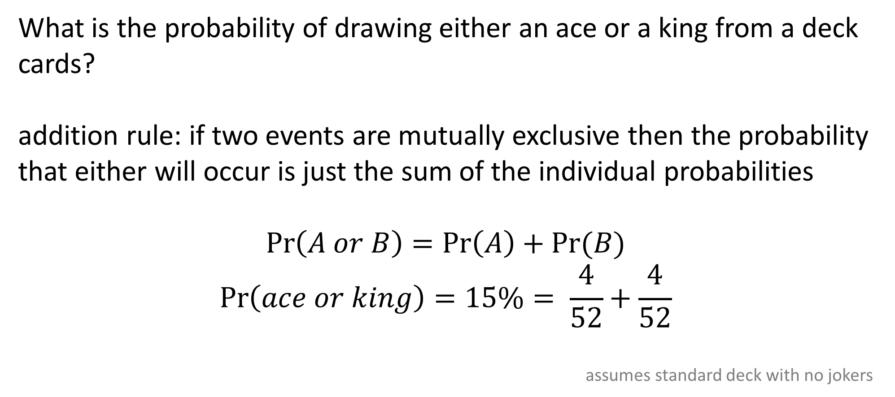
Mutually exclusive events
What is the probability of drawing either an ace or a king from a deck cards?
addition rule: if two events are mutually exclusive then the probability that either will occur is just the sum of the individual probabilities
$$\operatorname{Pr}\left(A or B\right)=\operatorname{Pr}\left(A\right)+Pr⁡(B)$$
$$\operatorname{Pr}\left(ace or king\right)=15\%= \frac{4}{52}+\frac{4}{52}$$
assumes standard deck with no jokers

Slide 11
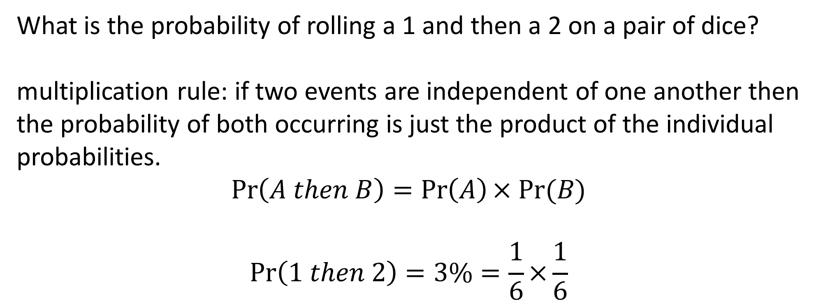
Independent events
What is the probability of rolling a 1 and then a 2 on a pair of dice?
multiplication rule: if two events are independent of one another then the probability of both occurring is just the product of the individual probabilities.
$$\operatorname{Pr}\left(A then B\right)=\operatorname{Pr}\left(A\right)× Pr⁡(B)$$
$$\operatorname{Pr}\left(1 then 2\right)=3\%=\frac{1}{6}×\frac{1}{6}$$

Slide 12
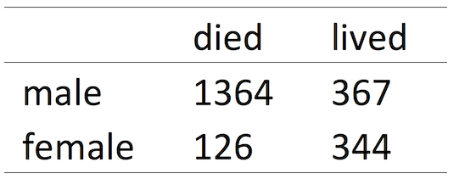
Non-independence
non-independent events- conditional probability: is the probability of an event given that another event has already occurred.
For instance, the probability of surviving the sinking of the Titanic was very different than the probability of surviving if you were a female

Slide 13
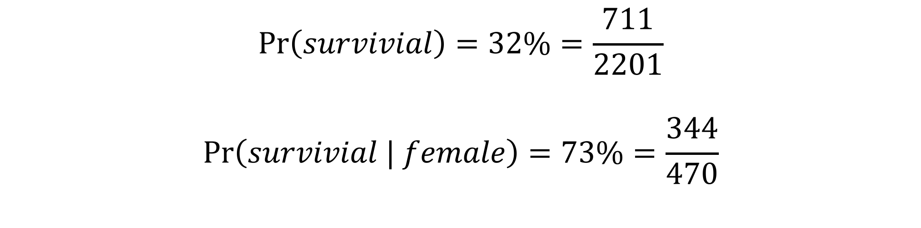
Conditional probability
$$\operatorname{Pr}\left(survivial\right)=32\%=\frac{711}{2201}$$
$$\operatorname{Pr}\left(survivial | female\right)=73\%=\frac{344}{470}$$

Slide 14
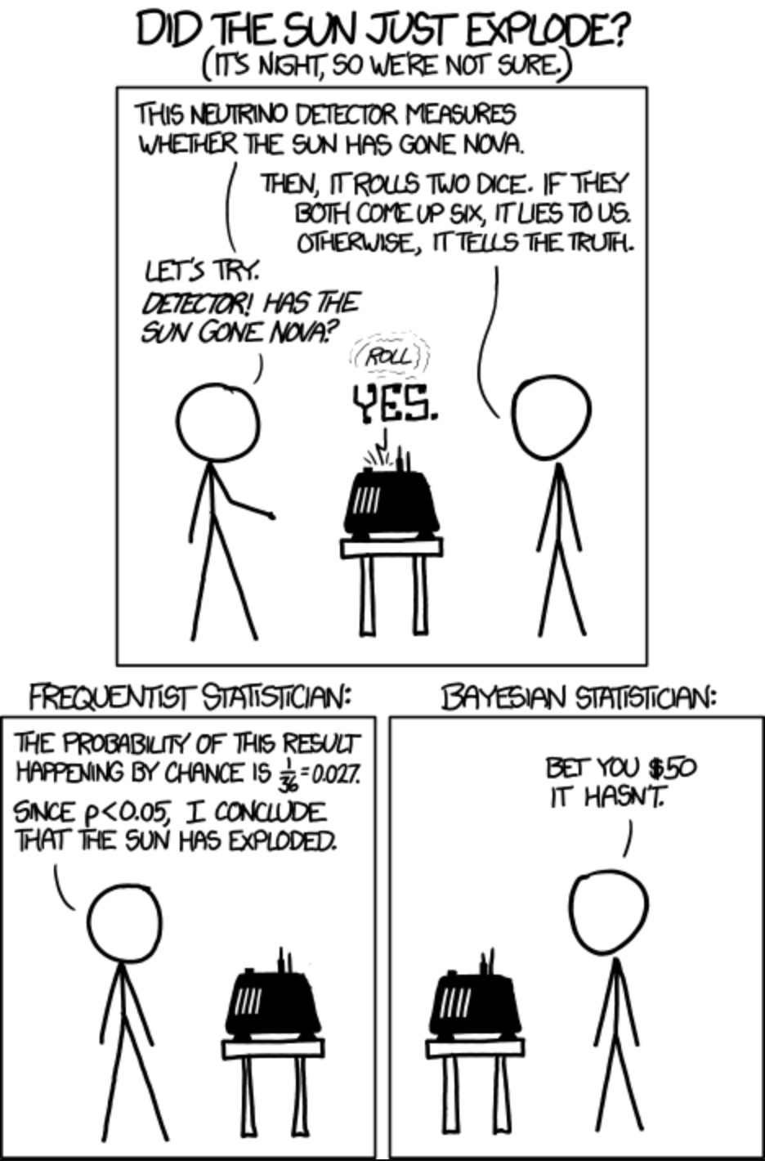
Frequentist and Bayesian

Slide 15
Frequentist and Bayesian
 | Frequentist | Bayesian
Hypothesis test | P-value | Bayes factors
Parameter estimation | Maximum likelihood with confidence interval | Posterior distribution

Slide 16
Frequentist and Bayesian
 | Frequentist | Bayesian
Hypothesis test | P-value | Bayes factors
Parameter estimation | Maximum likelihood with confidence interval | Posterior distribution

Slide 17
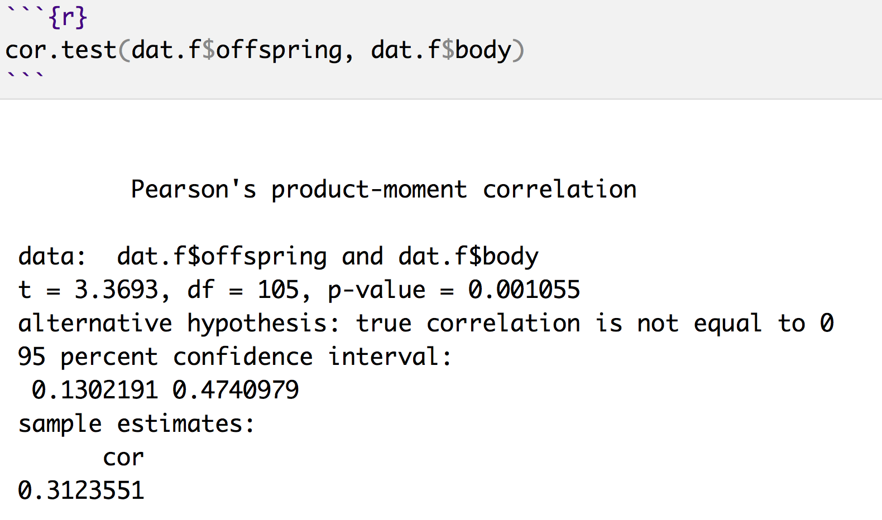
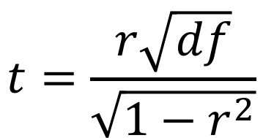
What is a p-value?
Is the probability of finding the observed, or more extreme, statistic when the null hypothesis is true.
$$t=\frac{r\sqrt{df}}{\sqrt{1−r^{2}}}$$

Slide 18
Frequentist and Bayesian
 | Frequentist | Bayesian
Hypothesis test | P-value | Bayes factors
Parameter estimation | Maximum likelihood with confidence interval | Posterior distribution

Slide 19
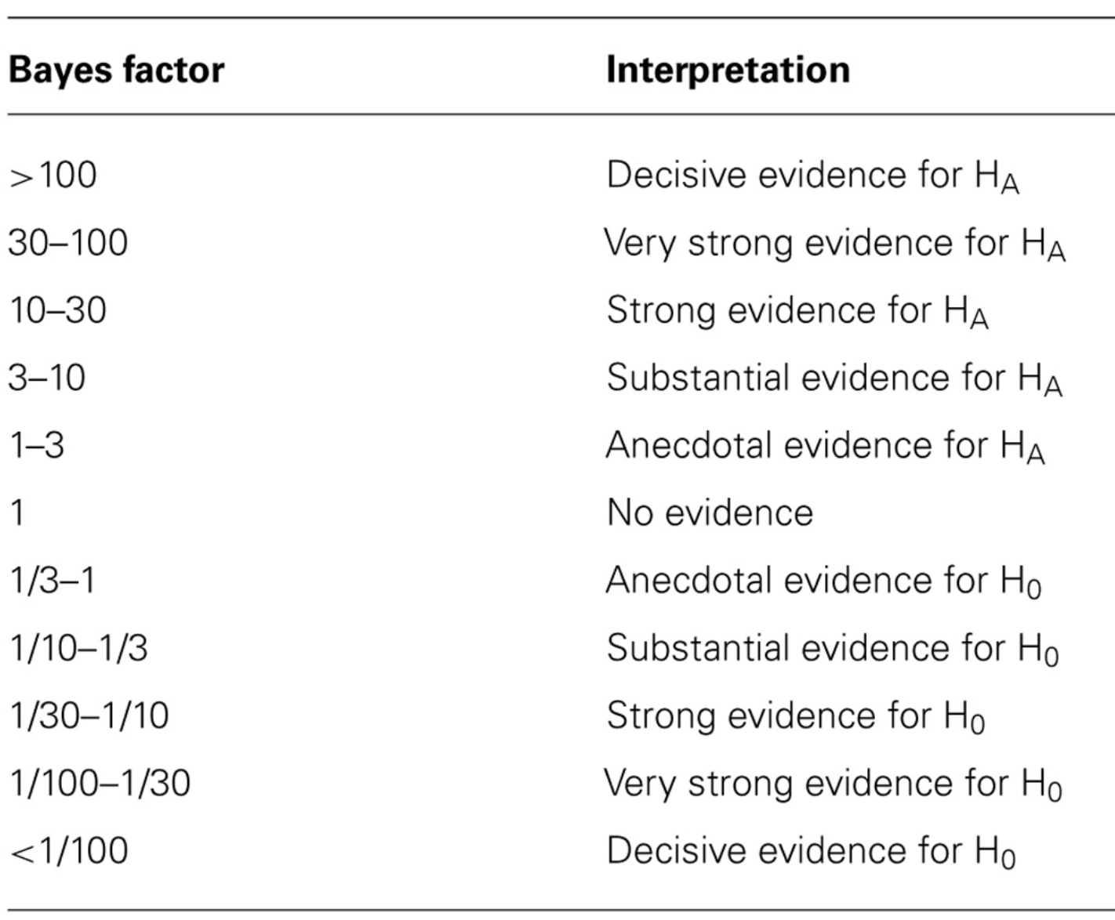
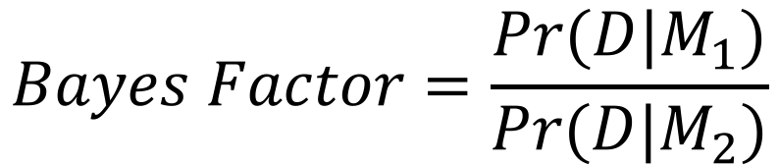
Frequentist and Bayesian
$$Bayes Factor=\frac{Pr⁡(D|M_{1})}{Pr⁡(D|M_{2})}$$

Slide 20
Frequentist and Bayesian
 | Frequentist | Bayesian
Hypothesis test | P-value | Bayes factors
Parameter estimation | Maximum likelihood with confidence interval | Posterior distribution

Slide 21
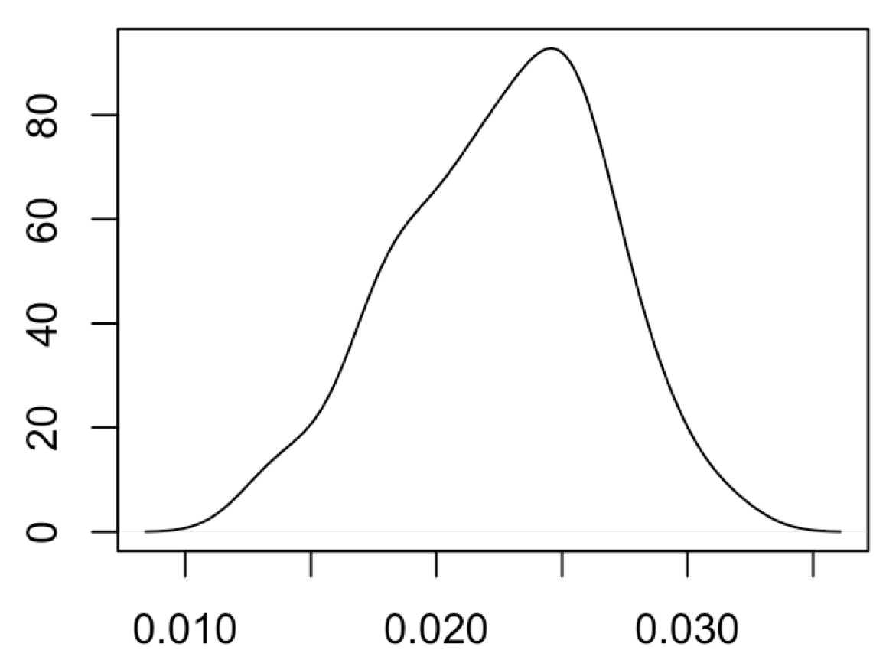
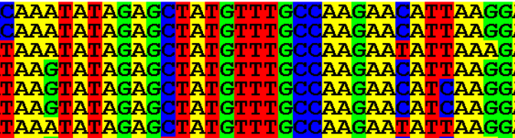
Frequentist parameter estimate
Everything is fixed except parameter of interest. Shape of likelihood determines estimate of the statistic
 | A | G | C | T
A |  | β | ⍺ | ⍺
G | β |  | ⍺ | ⍺
C | ⍺ | ⍺ |  | β
T | ⍺ | ⍺ | β
Pr(data)
Parameter values

Slide 22
Frequentist and Bayesian
 | Frequentist | Bayesian
Hypothesis test | P-value | Bayes factors
Parameter estimation | Maximum likelihood with confidence interval | Posterior distribution

Slide 23
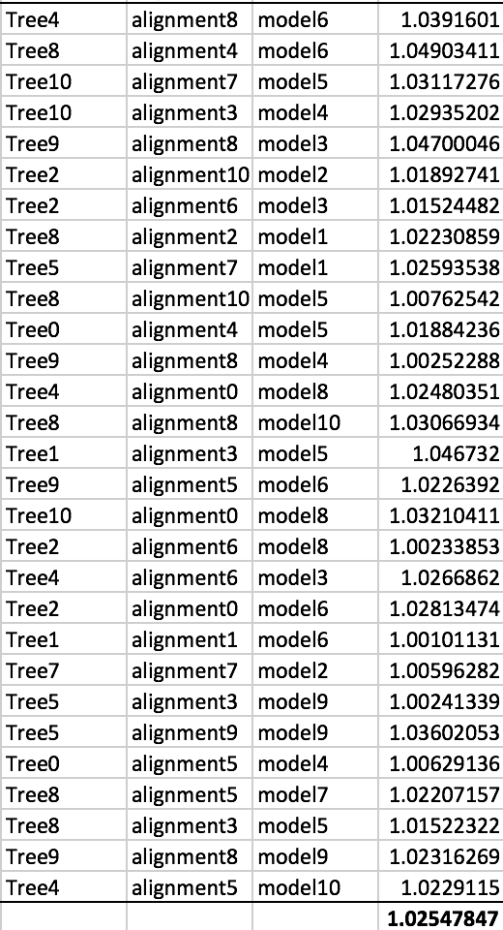
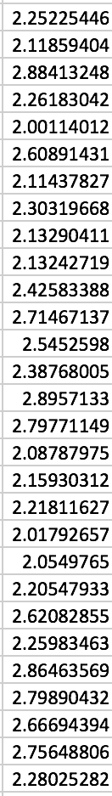
Bayesian parameter estimate
We create a marginal estimate of the statistic of interest
 | A | G | C | T
A |  | β | ⍺ | ⍺
G | β |  | ⍺ | ⍺
C | ⍺ | ⍺ |  | β
T | ⍺ | ⍺ | β

Slide 24
Frequentist and Bayesian

Slide 25
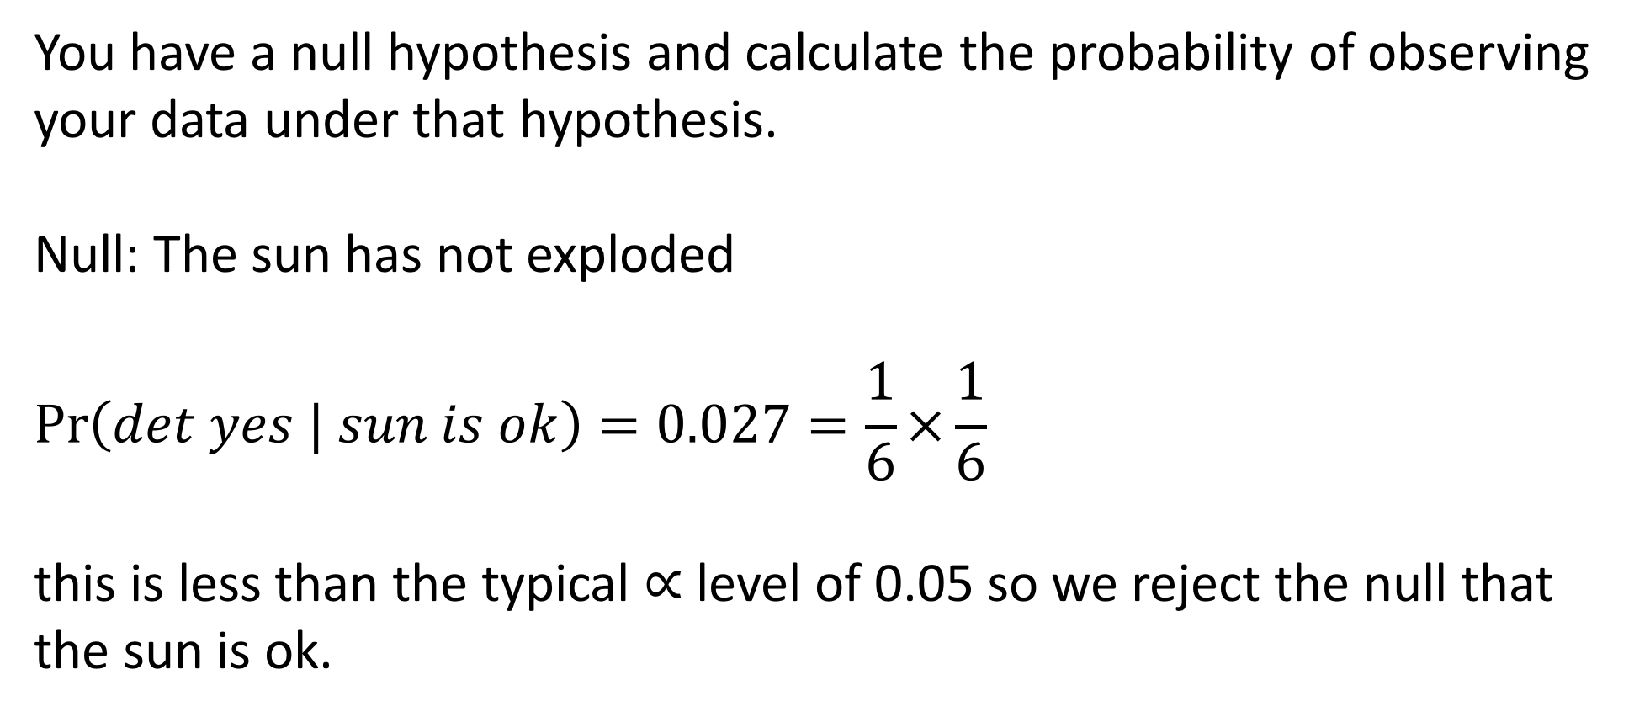
Frequentist approach
You have a null hypothesis and calculate the probability of observing your data under that hypothesis.
Null: The sun has not exploded
$$\operatorname{Pr}\left(det yes | sun is ok\right)=0.027=\frac{1}{6}×\frac{1}{6}$$
this is less than the typical $∝$ level of 0.05 so we reject the null that the sun is ok.

Slide 26
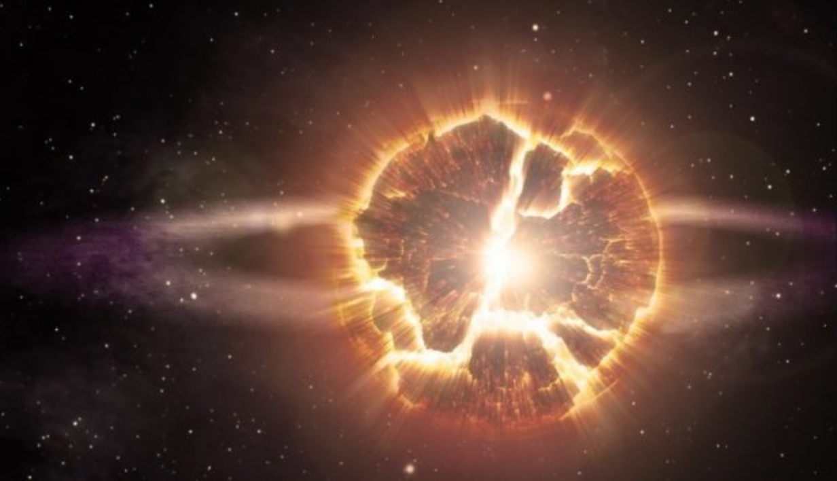
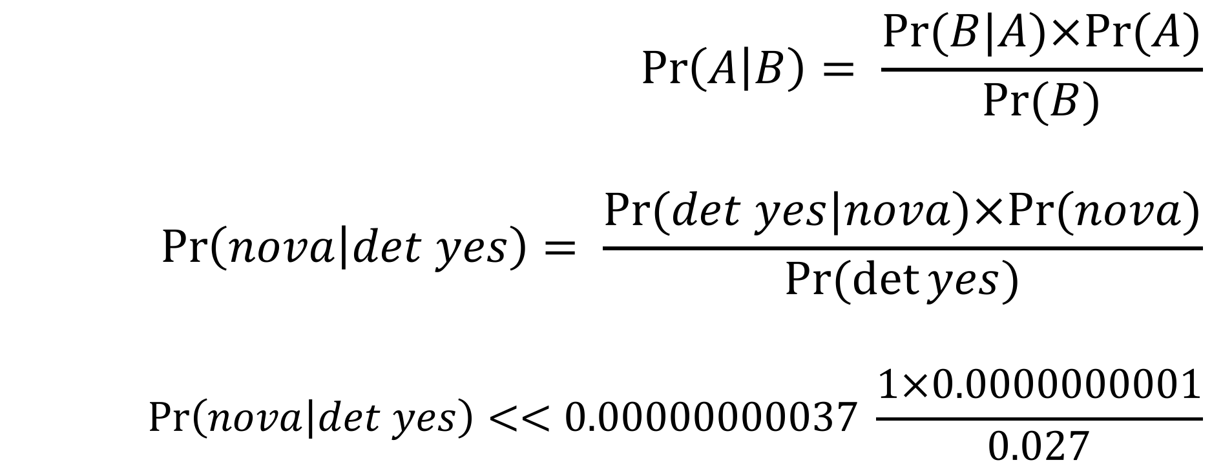
Bayesian approach
$$\operatorname{Pr}\left(A | B\right)= \frac{Pr⁡(B|A)×Pr⁡(A)}{Pr⁡(B)}$$
$$\operatorname{Pr}\left(nova | det yes\right)= \frac{Pr⁡(det yes|nova)×Pr⁡(nova)}{Pr⁡(\det{yes})}$$
$$\operatorname{Pr}\left(nova | det yes\right)<<0.00000000037 \frac{1×0.0000000001}{0.027}$$

Slide 27
Bayesian approach
Imagine a genetic mutation present in 1 person per 100,000. If you take a test that correctly returns a positive result 99.9% of the time when someone is infected but has a false positive rate of 0.5%.
How likely are you to have the disease if you test positive?
Should you be concerned if you test positive?
Bayes’ theorem provides a natural way to think about this.
Lets do this!

Slide 28
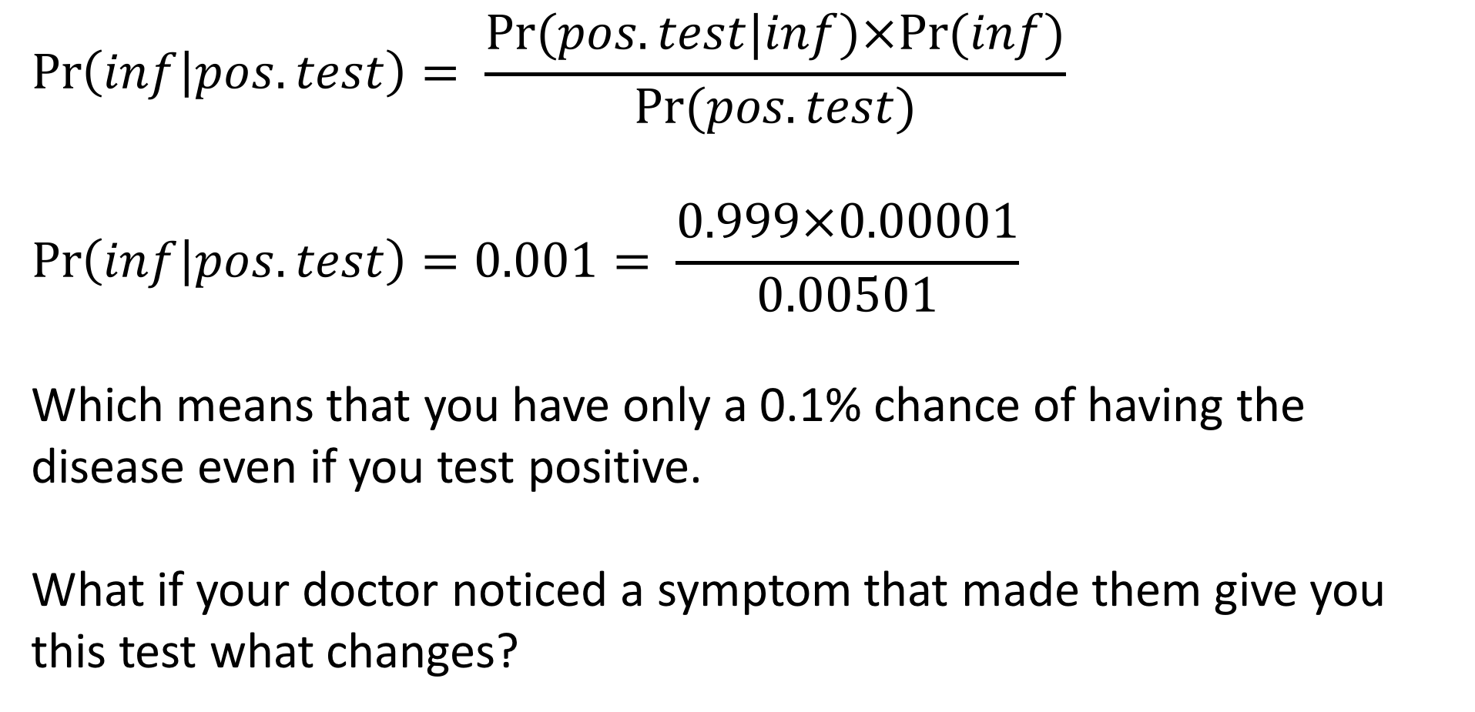
Bayesian approach
$$\operatorname{Pr}\left(inf | pos.test\right)= \frac{Pr⁡(pos.test|inf)×Pr⁡(inf)}{Pr⁡(pos.test)}$$
$$\operatorname{Pr}\left(inf | pos.test\right)=0.001= \frac{0.999×0.00001}{0.00501}$$
Which means that you have only a 0.1% chance of having the disease even if you test positive.
What if your doctor noticed a symptom that made them give you this test what changes?

Slide 29
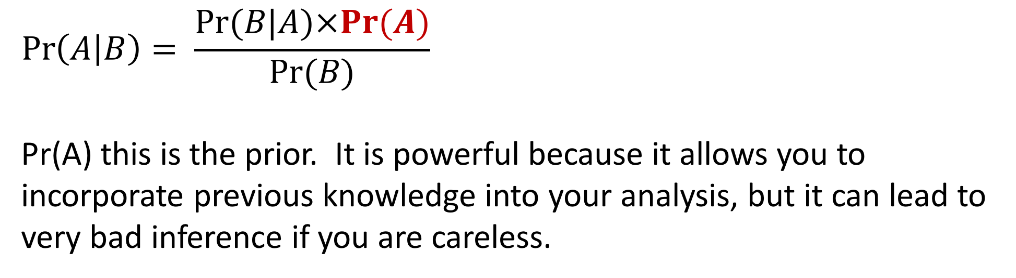
Priors
$$\operatorname{Pr}\left(A | B\right)= \frac{Pr⁡(B|A)×Pr⁡(A)}{Pr⁡(B)}$$
Pr(A) this is the prior. It is powerful because it allows you to incorporate previous knowledge into your analysis, but it can lead to very bad inference if you are careless.

Slide 30
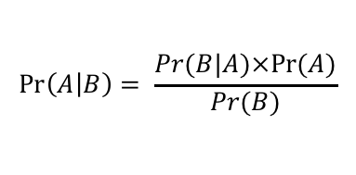
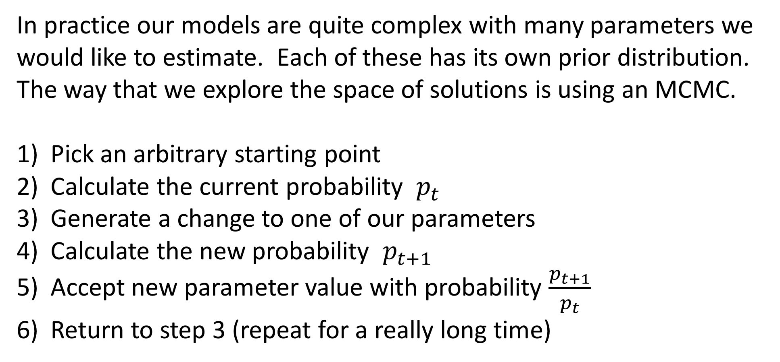
Bayesian methods in practice (MCMC)
In practice our models are quite complex with many parameters we would like to estimate. Each of these has its own prior distribution. The way that we explore the space of solutions is using an MCMC.
Pick an arbitrary starting point
Calculate the current probability $p_{t}$
Generate a change to one of our parameters
Calculate the new probability $p_{t+1}$
Accept new parameter value with probability $\frac{p_{t+1}}{p_{t}}$
Return to step 3 (repeat for a really long time)
$$\operatorname{Pr}\left(A | B\right)= \frac{Pr⁡(B|A)×Pr⁡(A)}{Pr⁡(B)}$$

Slide 31
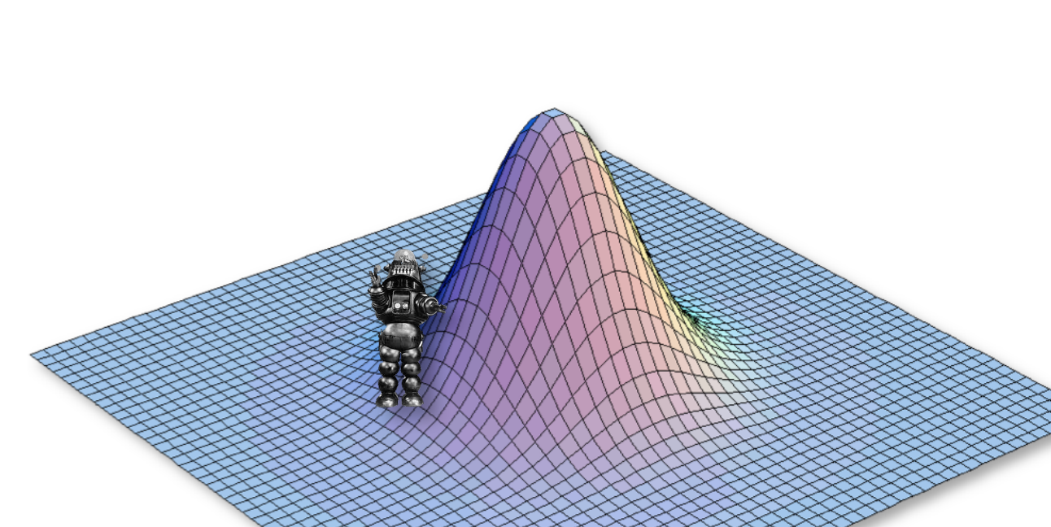
Bayesian methods in practice (MCMC)

Slide 32
Bayesian methods in practice (MCMC)

Slide 33
Bayesian methods in practice (MCMC)

Slide 34
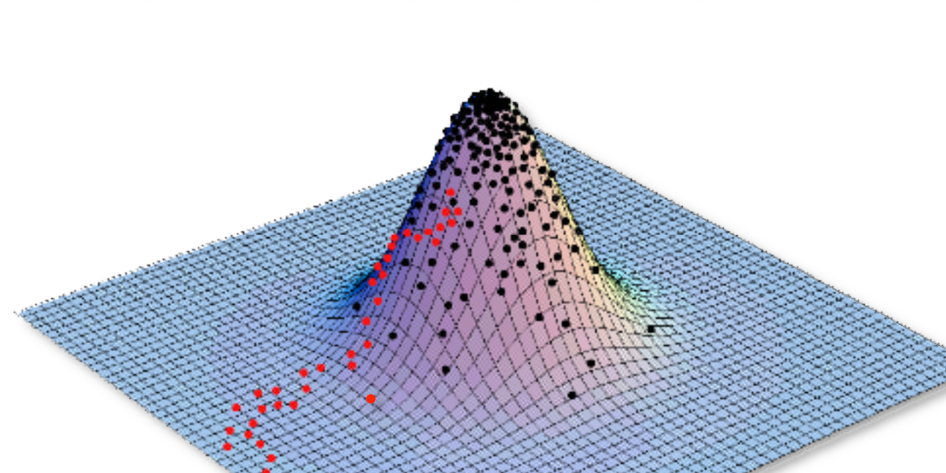
Bayesian methods in practice (MCMC)

Slide 35
The power of Bayesian approaches
With a Bayesian approach we can take into account all types of uncertainty and be more conservative.
Phylogenetic
Model selection uncertainty
Parameter value uncertainty
Uncertainty in measurements

Slide 36
For Thursday
Bring laptop to class!
Heath Blackmon
BSBW 309
coleoguy@gmail.com
@coleoguy

Slide 37
Thursday
Load and evaluate an MCMC log file
calculate out Bayes theorem problem
Homework complete HW3 on ecampus

